Slide 1
Recommendation System for Olist E-commerce Retailer
NYU x Peak Datathon
Blow Up the Pipeline Team

Slide 2
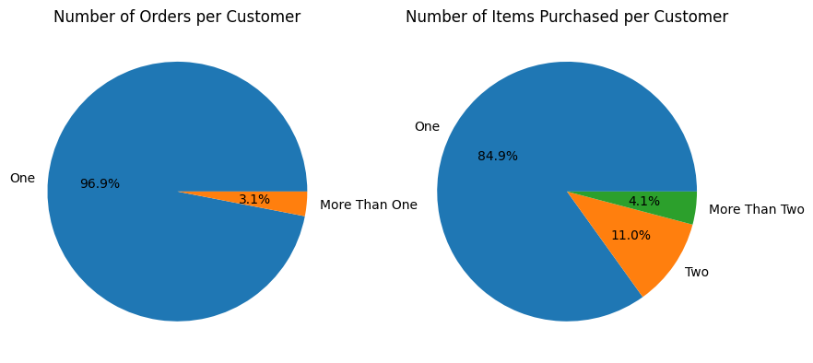
Purchase History
– Most customers only ordered once & purchased one item
Very limited amount of validation data prompt us to adopt simple approaches over complex time-series based models.
Notes:
In our EDA, we found that most customers only ordered once with one item in it. We cannot validate our recommendation unless there are two items or two orders for a customer. Because of the very limited amount of validation data, we adopt simple approaches over complex time-series based models.

Slide 3
Framework
The customer-product interactions are sparse in the Olist dataset, with 85% customers only having one purchase record.
Therefore we construct our recommendation system from three aspects:
Customer-to-customer recommendation based on Bayesian Classifiers
Product-to-product recommendation based on Category Similarity
Intrinsic product features
Notes:
This is the framework of our apporach

Slide 4
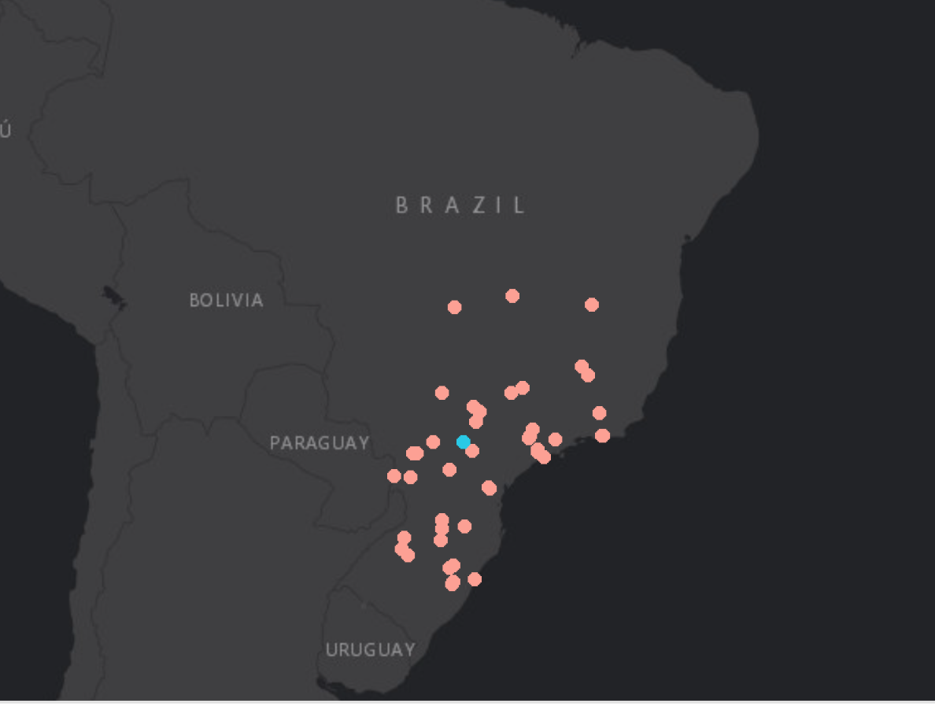
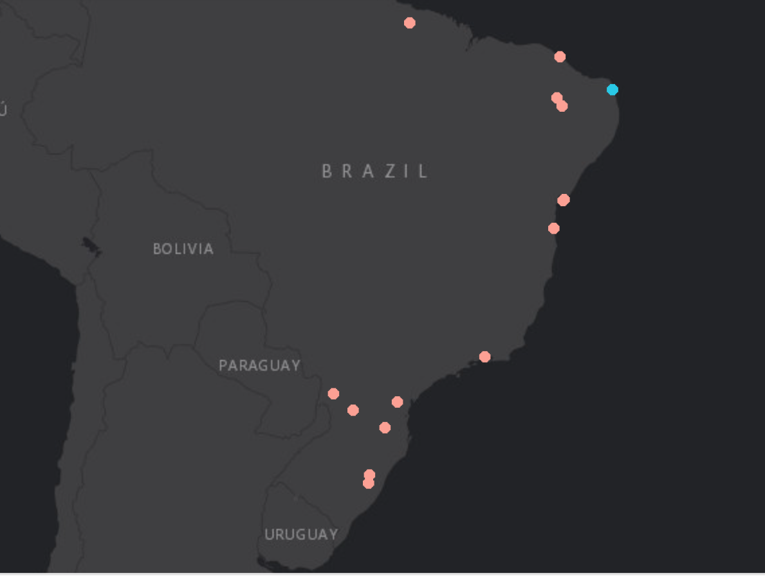
Geographical Information Matters
— A geovisualization of two representative sellers and their customers
Seller in the south & its customers
Seller in the north & its customers
Notes:
This is the geoplot of customers and sellers. The left plot is a seller in the south which is the blue dot and all customers of this seller which are the pink dots. As you can see, most customers are located near the seller. The right plot is a seller in the north and all customers of the seller. Although only half of the customers are located around the seller, it is still reasonable to conclude that the distance between the seller and the customers matter given that majority of Brazilian people is in the south.

Slide 5
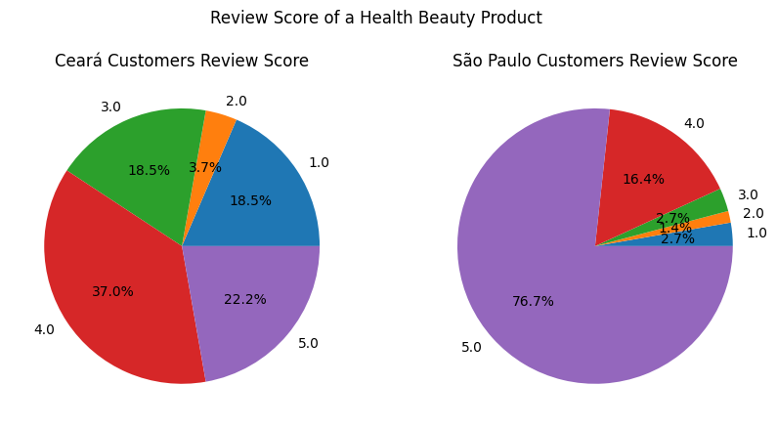
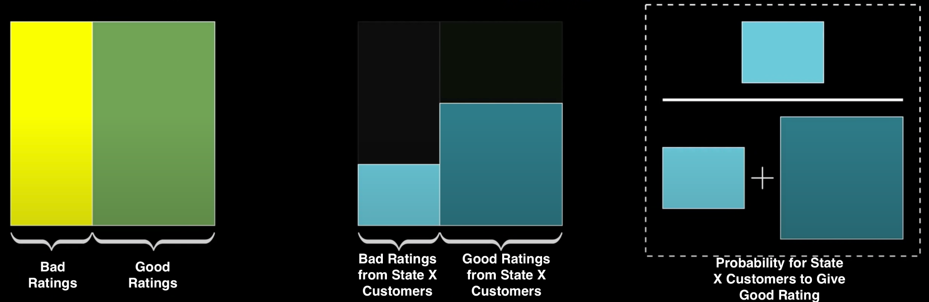
Part 1: Bayesian Inference
Recommend products that are either:
Popular in general, or
Especially favored by customers from the same state.

Slide 6
Part 2: Category Similarity
We only have very limited customers who purchase more than one items, but we have plenty of vendors selling multiple products.
This motivates us to measure category similarities based on the assumptions that if two categories of products are sold by the same seller, they tends to be more similar.

Slide 7
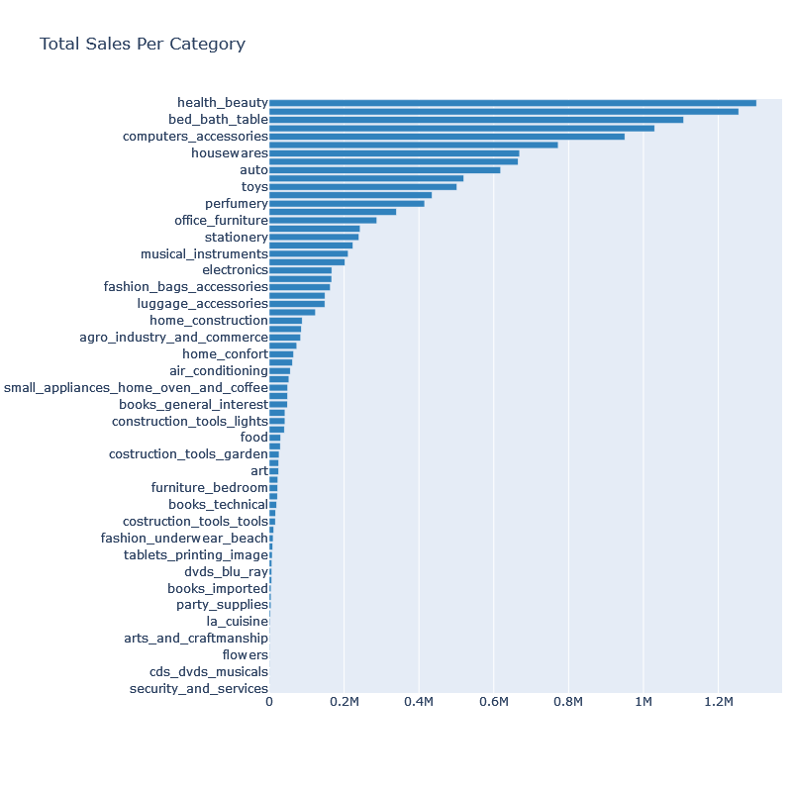
Category Ranking
by Total Sales
Top 5 categories:
Health & beauty
Bed & bath table
Computers accessories
Housewares
Auto

Slide 8
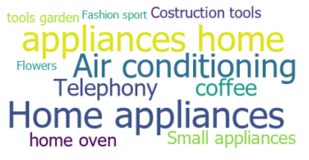

Examples of Category Groups
— Similar categories are grouped together as expected
Group 1
Group 2

Slide 9
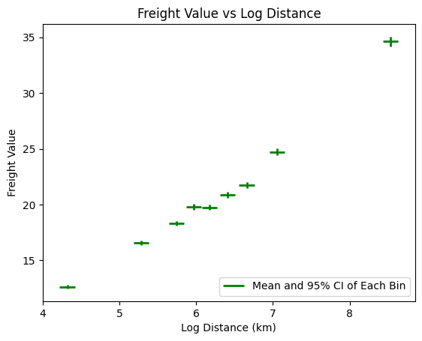
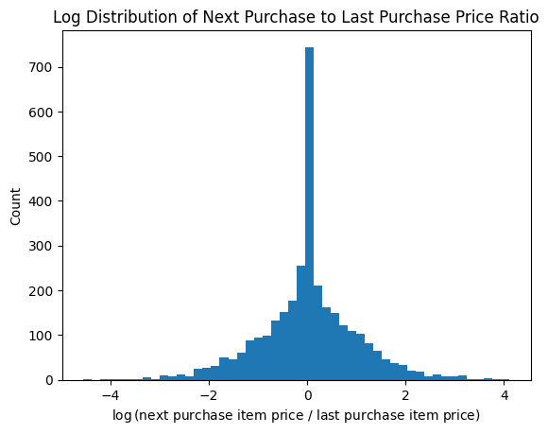
Part 3: Intrinsic Product Features
Validate the importance of selected features
The following product features are taken into consideration:
Average ratings
Price difference between products and customers’ historical purchases
Distance between product sellers and customers

Slide 10
Final Part: Ensemble Model
Bayesian Inference
Ensemble takes advantage of different models and exploits different data information.
The weights for different models are trained (e.g. grid search) using the limited customer purchase history.
Ensemble
Category Similarity
Ranking
Other Features
Notes:
Finally, we incorporate all our previous parts into an ensemble model, so it can take advantage of all the methods and data.
We train the weights using the customer purchase history.
In the plot, you can see that:
the three parts go into our ensemble model, which produces a final ranking. Our recommendation is based on the ranking.

Slide 11
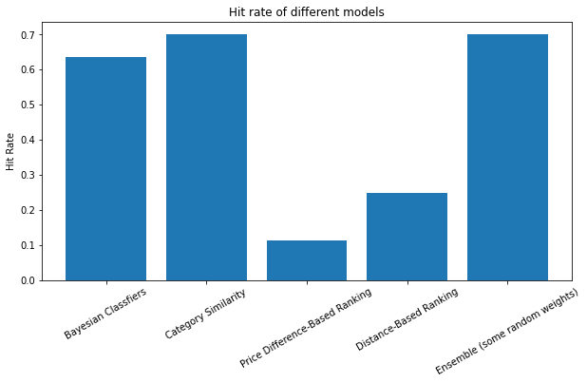
Final Results
All models have some classification power
Category similarity has the best predicting power
Since we have limited customer-product interactions, the performance is not yet satisfying for industrial requirements
Notes:
We compare the results of all our separate models and the final ensemble model.

Slide 12
Thank you!

Slide 13
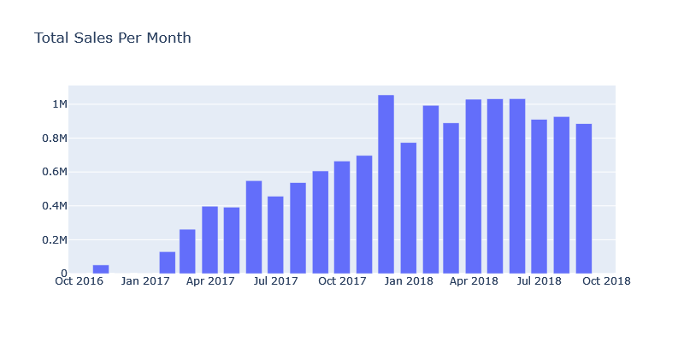
Appendix: Time Series Analysis for Sales
Increased Sales in 2018

Slide 14
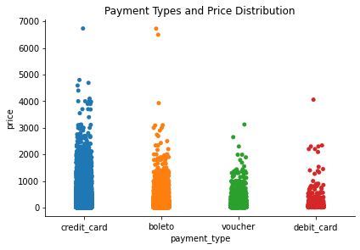
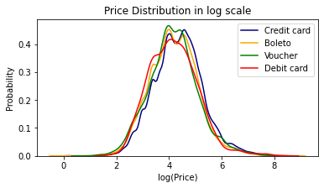
Appendix: Price Distribution by Payment Types
78% payment through credit cards, mean price is R$153

